Slide 1



377 Operating Systems
Join on Zoom if you are remote (see website for link).
01 Course Introduction

Slide 2

Welcome to COMPSCI 377 Operating Systems

Slide 3
Statement of Inclusivity
The staff for this course support the UMass commitment to diversity, and welcome individuals regardless of age, background, citizenship, disability, sex, education, ethnicity, family status, gender, gender identity, geographical origin, language, military experience, political views, race, religion, sexual orientation, socioeconomic status, and work experience. In this course, each voice in the classroom has something of value to contribute. Please take care to respect the different experiences, beliefs and values expressed by students and staff involved in this course.

Slide 4
Description
In this course we examine the important problems in operating system design and implementation. The operating system provides a well-known, convenient, and efficient interface between user programs and the bare hardware of the computer on which they run. The operating system is responsible for allowing resources (e.g., disks, networks, and processors) to be shared, providing common services needed by many different programs (e.g., file service, the ability to start or stop processes, and access to the printer), and protecting individual programs from one another. The course will start with a brief historical perspective of the evolution of operating systems over the last fifty years, and then cover the major components of most operating systems. This discussion will cover the tradeoffs that can be made between performance and functionality during the design and implementation of an operating system. Particular emphasis will be given to three major OS subsystems: process management (processes, threads, CPU scheduling, synchronization, and deadlock), memory management (segmentation, paging, swapping), file systems, and operating system support for distributed systems.
4 Credits

Slide 5
Prerequisites
COMPSCI 230 Computer Systems Principles
Or equivalent background

Slide 6
Major Applicability
This course counts as a 300-level Computer Science Major elective.

Slide 7
Textbook
Operating Systems: Three Easy Pieces, Remzi H. Arpaci-Dusseau and Andrea C. Arpaci-Dussea.
This is a free textbook available online. While the entire textbook is available for free from this site, if you so wish, a hard copy may be purchased on Amazon.
This book is absolutely fabulous as far as OS books go.

Slide 8
Software Platforms
We will be using a few software platforms as part of the management of this course.
Course Website: https://umass-cs-377.github.io
Moodle
Piazza
Zoom
Echo360
Gradescope
Edlab
VSCode

Slide 9
Course Website
The course website has (or will have) all the course material. I am currently in the process of converting it all from our previous infrastructure (i.e., Moodle).
You will also find due dates for assignments on the website.
This make a little bit of time, so please be patient ☺

Slide 10
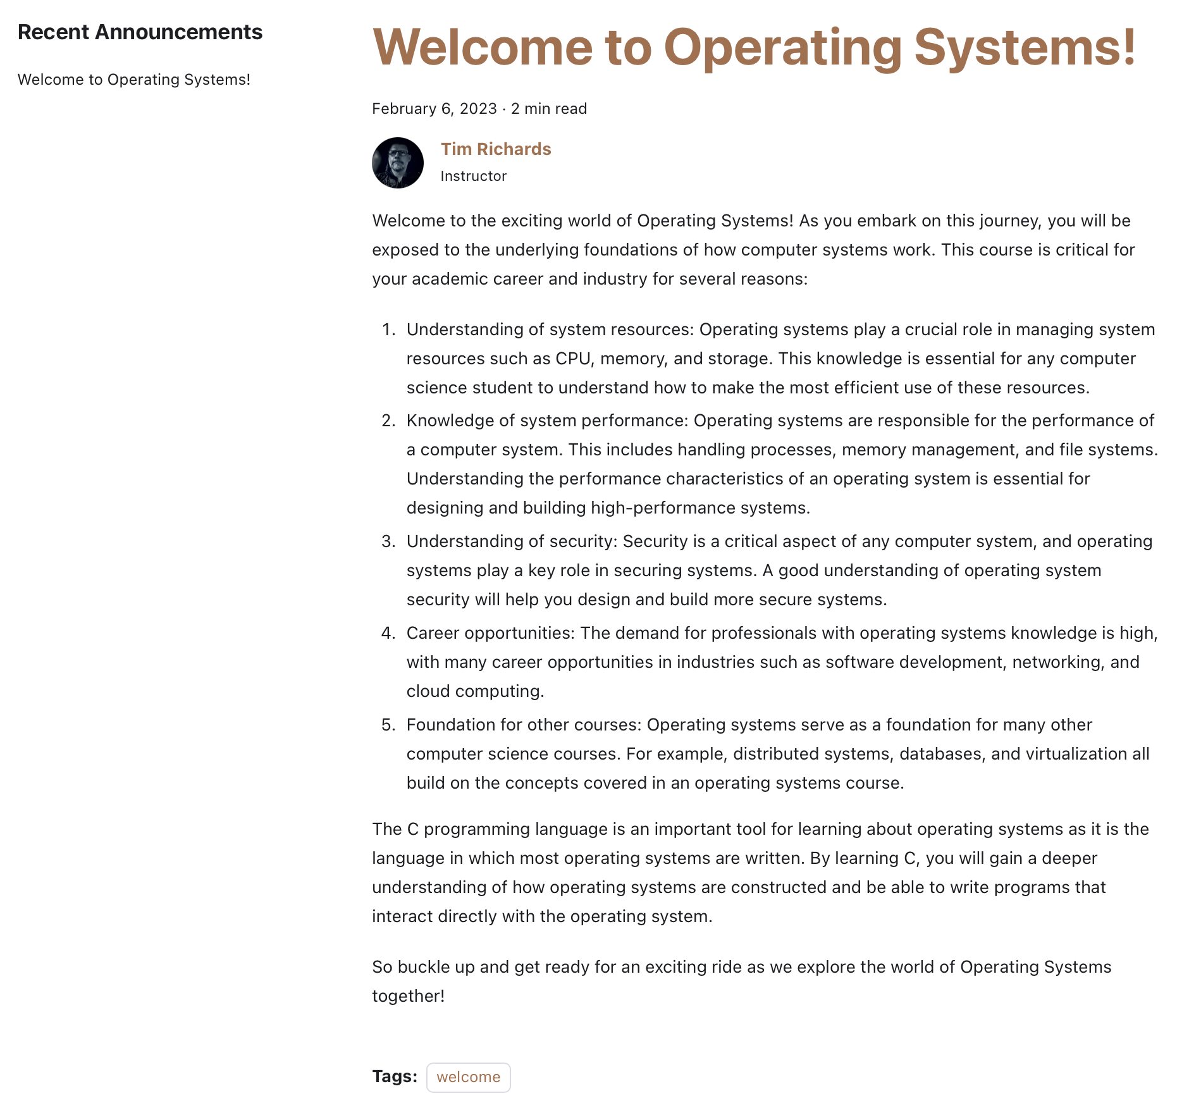
Course Website
The course website also has an “Announcements” section where we will post course updates.

Slide 11
Moodle
Moodle is used for links to software platforms you need to register for (e.g., Piazza, Gradescope).
It is a springboard to everything else in the course.
At the moment, we are looking to not use the Moodle gradebook, rather we will be sending grades over email.

Slide 12
Piazza
Piazza is used to communicate with the course staff and other students.
You can ask questions, post answers, and discuss course material.
You can also use Piazza to communicate with the course staff privately.

Slide 13
Zoom and Echo360
All class meetings will be synchronously streamed on Zoom.
All class meetings will be recorded by Zoom and uploaded to Echo360 at the end of class.
You will be able to access the class on Zoom if you are unable to make it to class in-person.
If you are unable to make it to class for a personal reason, you can view the recorded class meeting asynchronously.
DO NOT ABUSE THIS!

Slide 14
Software Tools
We will use a variety of software tools in this course. The most important that you will need to install on your computer are:
Visual Studio Code (VSCode)
You will be doing all your coding in the Edlab environment. The Edlab environment is a cluster of Linux machines with all the installed software that you need.
You can use VSCode to remotely connect to the Edlab and code like you are on your own machine. Very nice.
Or you can optionally use emacs, vim, or nano.

Slide 15
Lecture Format
Lectures will be led by the professor and provide a high-level overview of the course material.
The presentation format will include a variety of slides, written notes, programming examples, activities, etc.
You are expected to attend every lecture for your section and arrive promptly, so you do not disturb others.
You may use electronic devices during class; however, its use must pertain to the activity at hand.

Slide 16
Discussion Format
The discussion section is led by teaching assistants (TAs) for this course.
There will also be undergraduate course assistants (UCA) assigned to your discussion section.
You are expected to attend every discussion section.
Discussions are used to begin discussion assignments and get help completing those assignments. Missing a discussion section does not excuse you from any activities that occur during that time. Do not ask to make up any missed work during discussion section time.

Slide 17
What happens if I can’t attend a lecture or a discussion?
Although we want you to attend the lecture, we understand that sometimes that isn’t always possible. For that reason, we provide flexible options that allow you to participate.
Remote Synchronous: attend the lecture remotely on Zoom and ask questions through the chat system.
Asynchronous: watch the recorded lecture at a time that is convenient for you.
Unless you have special arrangements, please do not assume that you can attend fully remote. We do want you in class to engage with the class!
Discussions are not zoomed/recorded. However, you must complete the discussion exercise.

Slide 18
Assignments and Grading
(40%) Project Assignments
(20%) Weekly Quizzes
(15%) Lab Exercises
(25%) Final Project

Slide 19
(40%) Project Assignments
There are approximately 6 projects that are hands on with programming as it relates to the material.
You will be provided a “starter” project, but will require additions, modifications, or tasks to complete it.
Most projects come with some tests (but not all) to guide you.
You submit your projects to Gradescope which will run our auto-grader and apply additional private tests.
You are allowed to work collaboratively on these projects and submit as a team.

Slide 20
(20%) Weekly Quizzes
Weekly quizzes will test your knowledge of the material.
There will a quiz most weeks.
They will be multiple choice, true/false, etc.
They will not be timed.
You may take them as many times as you need to until you achieve 100%.
They are available for about a week.

Slide 21
(15%) Lab Exercises
A discussion exercise is a short activity that will focus on expanding your knowledge in a particular topic area.
They are often designed to provide guidance for an upcoming project or to enhance your understanding of the content for that week.
They are completed on Gradescope.
They are graded both automatically and manually.

Slide 22
(20%) Final Project
Towards the end of the semester, you will complete a final project.
You will work collaboratively in groups of 4 members to design and implement a programming project.
You will produce your own idea for the project and complete it by the end of the semester.

Slide 23
Office Hours
Office hours are times when we provide real-time access to the instructor, TAs, and UCAs.
You do not need an appointment to attend office hours, attendance is optional, and all questions you have about the course are welcome.
These sessions will be held at several different times during the week.
Office hours will be posted on the course website as soon as we are able to schedule them.
Office hours will be both in-person and on Zoom

Slide 24
Accommodations
The University of Massachusetts Amherst is committed to providing an equal educational opportunity for all students.
If you have a documented physical, psychological, or learning disability on file with Disability Services (DS), you may be eligible for reasonable academic accommodations to help you succeed in this course.
If you have a documented disability that requires an accommodation, please notify me as soon as possible so that we may make appropriate arrangements.
For further information, please visit Disability Services (https://www.umass.edu/disability/).

Slide 25
Academic Honesty
Although you are allowed to collaborate on everything in this course, you must still adhere to the academic honesty policies of the university.
You may not steal other student’s work.
You must participate in the collaboration.
You may not force or coerce anyone to give you the answer.
The goal is for you to learn. The hope is this collaborative environment will allow you to experiment more freely with assignments without the pressure.

Slide 26
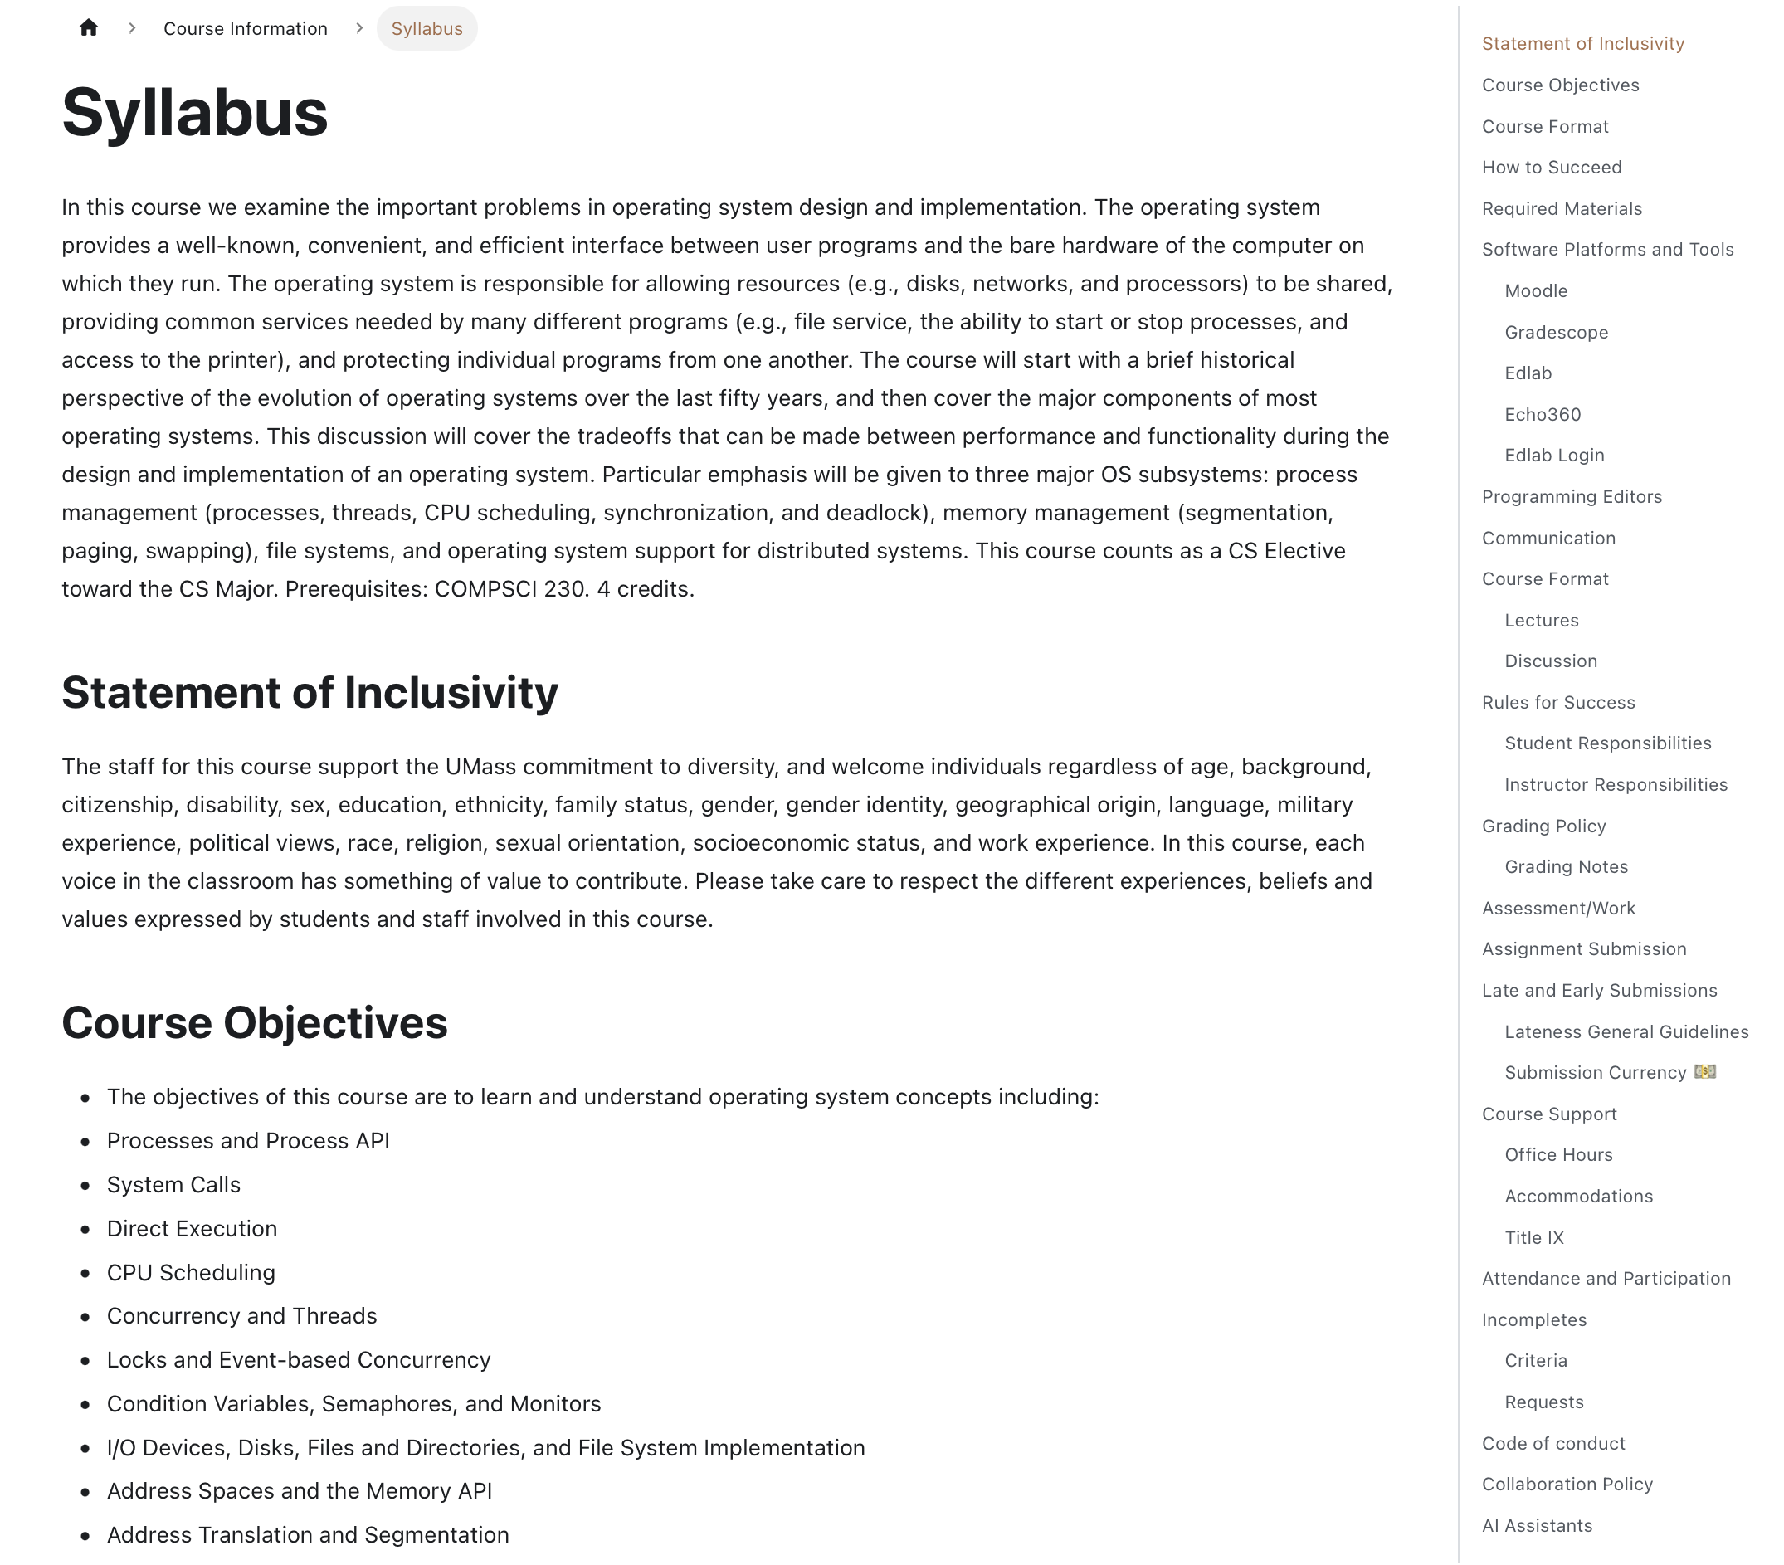
Syllabus
The syllabus is the primary resource for all details regarding the course
You should consult the syllabus for all aspects of the course
There may be circumstances where the syllabus needs to be updated, so always visit the syllabus online to ensure you are reading the most updated information

Slide 27
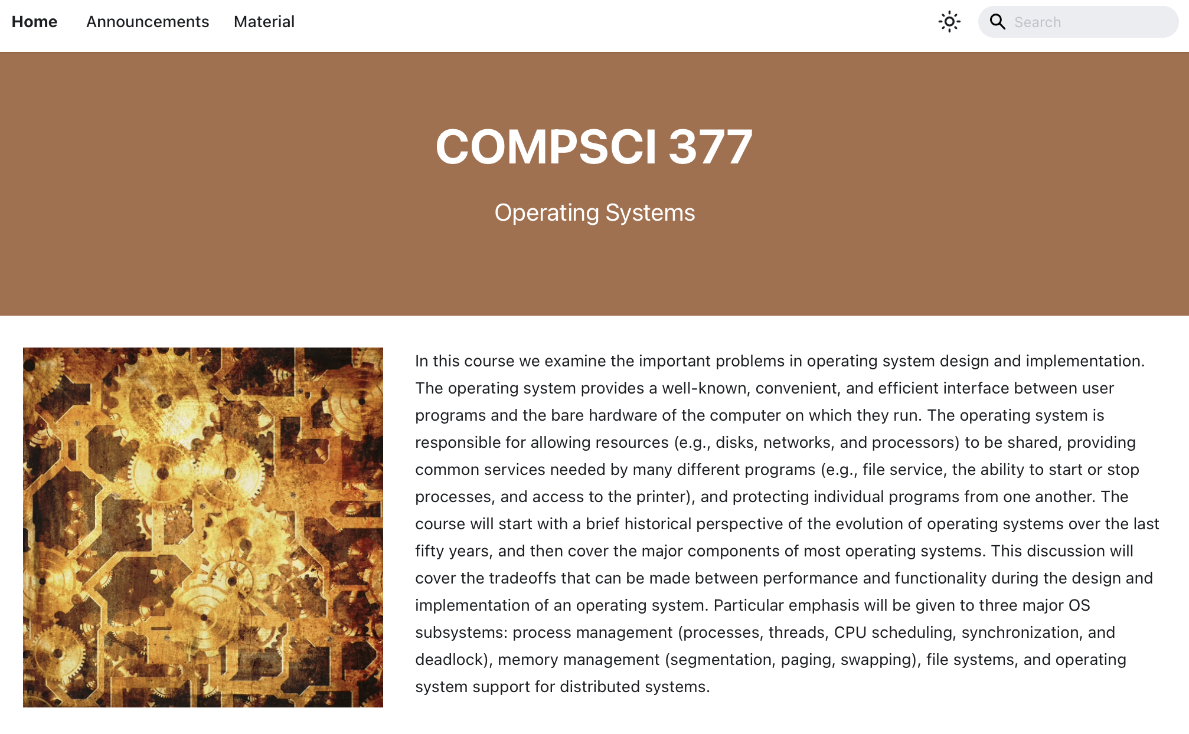
Website
Let’s take a look at the website to get a better idea of what this all looks like.

Slide 28

VSCode + Edlab
Connecting to the Edlab remotely using VSCode.
How does it work?

Slide 29
What’s An OS?
Interface between the user and the machine architecture.
Implements a virtual machine that is (hopefully) easier to program than raw hardware.
11

Slide 30
OS
Interface between user and architecture: Hides architectural details
Implements virtual machine: Easier to program than raw hardware
Illusionist Bigger, faster, reliable
Government: Divides resources, “Taxes” = overhead
User-level Applications
virtual machine interface
Operating System
physical machine interface
Hardware
13

Slide 31
Most Important Features
Services: The OS provides standard services (the interface) which the hardware implements.
File system, virtual memory, networking, CPU scheduling, and time-sharing

Slide 32
Most Important Features
Services: The OS provides standard services (the interface) which the hardware implements.
File system, virtual memory, networking, CPU scheduling, and time-sharing
Coordination: The OS coordinates multiple applications and users to achieve fairness and efficiency (throughput).
Concurrency, memory protection, networking, and security.

Slide 33
Most Important Features
Services: The OS provides standard services (the interface) which the hardware implements.
File system, virtual memory, networking, CPU scheduling, and time-sharing
Coordination: The OS coordinates multiple applications and users to achieve fairness and efficiency (throughput).
Concurrency, memory protection, networking, and security.
Goal: Design an OS so that the machine is convenient to use (a software engineering problem) and efficient (a system and engineering problem).

Slide 34
Why Study OS?
Hilariously: You are unlikely to get a job building an OS.

Slide 35
Why Study OS?
Hilariously: You are unlikely to get a job building an OS.
However, Understanding operating systems will enable you to use your computer more effectively.

Slide 36
Why Study OS?
Hilariously: You are unlikely to get a job building an OS.
However, Understanding operating systems will enable you to use your computer more effectively.
Why does my application run slowly?

Slide 37
Why Study OS?
Hilariously: You are unlikely to get a job building an OS.
However, Understanding operating systems will enable you to use your computer more effectively.
Why does my application run slowly?
How can I make my application cheaper to run?

Slide 38
Why Study OS?
Hilariously: You are unlikely to get a job building an OS.
However, Understanding operating systems will enable you to use your computer more effectively.
Why does my application run slowly?
How can I make my application cheaper to run?
It will also serve as an excellent example of system design issues whose results and ideas you will apply elsewhere.

Slide 39
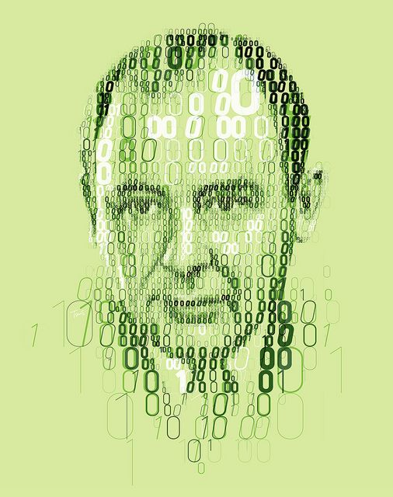
Introduction to Operating Systems
What happens when a program runs?

Slide 40
Introduction to Operating Systems
What happens when a program runs?
It does one simple thing: Executes instructions! Many millions (or event billions) of times every second

Slide 41
Introduction to Operating Systems
What happens when a program runs?
It does one simple thing: Executes instructions! Many millions (or event billions) of times every second
The processor
Fetches an instruction
Decodes that instruction
Executes that instruction (add, subtract, move, load, store)
Checks conditions
Moves on to the next instruction and does it again

Slide 42

Introduction to Operating Systems
Thus, we have just described the Von Neumann model of computing.
Sounds simple, right?
But in this class, we will be learning that while a program runs…
lots of other wild things are going on with the primary goal of making the system easy to use.

Slide 43
Introduction to Operating Systems
There is a body of software that is responsible for making it easy to run programs.

Slide 44
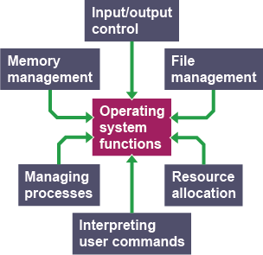
Introduction to Operating Systems
There is a body of software that is responsible for making it easy to run programs.
Allowing programs to share memory…
Enabling programs to interact with devices…
… and other fun stuff like that!
This body of software is called the operating system (OS).

Slide 45
Virtualization
The primary mechanism the OS uses to accomplish this is virtualization.

Slide 46
Virtualization
The primary mechanism the OS uses to accomplish this is virtualization.
The OS takes a physical resource (e.g., processor, memory, disk) and transforms it into a more general, powerful, and easy-to-use virtual form of itself.
Thus, we sometimes refer to the operating system as a virtual machine.

Slide 47
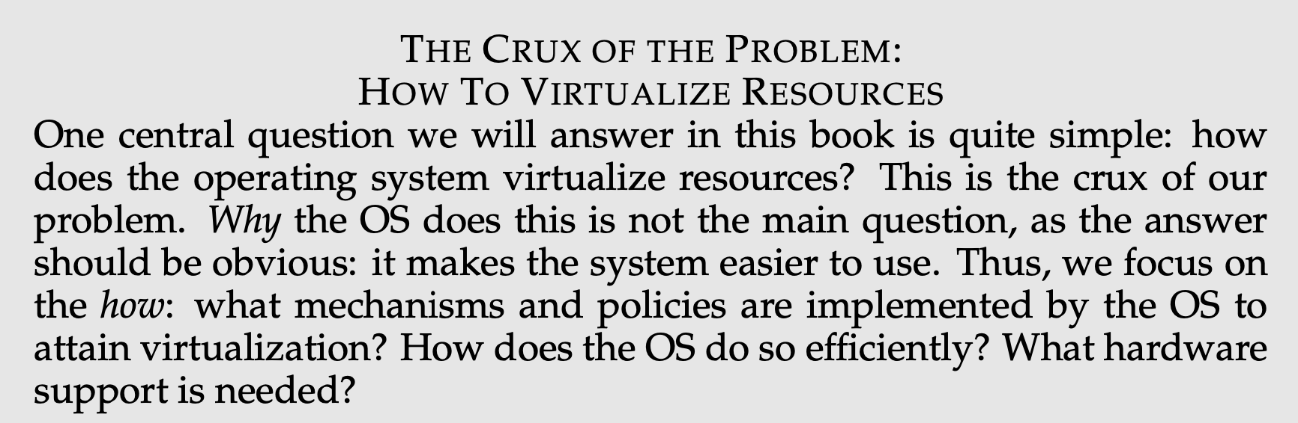
How to Virtualize Resources

Slide 48
How to Virtualize Resources

Slide 49
How to Virtualize Resources

Slide 50
How to Virtualize Resources

Slide 51
How to Virtualize Resources

Slide 52
How to Virtualize Resources

Slide 53
How to Virtualize Resources

Slide 54
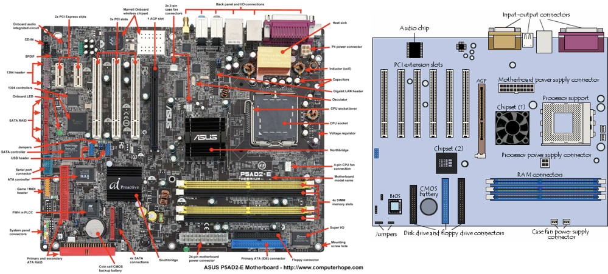
What are we Virtualizing?
Notes:
Picture of a motherboard/logicboard
Point out CPU, RAM slots, ports (ethernet for instance), USB ports
PCI slots for additional components

Slide 55

The End

